Slide 1
ESE-4009 Embedded System Design Project
Submitted by: GROUP 3
Jerin Joy
Kiran Anto Sebastian
Shinu Raj

Slide 2
The Current State Of The Art And Emerging Technology
Keylime - Remote trust for IoT, Edge, Cloud
Azure RTOS
Zephyr

Slide 3
Keylime
Open source TPM project for remote trust of IoT
A hardware root of trust (RSA key pair inaccessible by software)enables users to monitor remote nodes using a hardware based cryptographic root of trust.
Remote attestation - Each time a system call is made, IMA makes a cryptographic hash, which is compared to a list of expected entrusted system state.

Slide 4
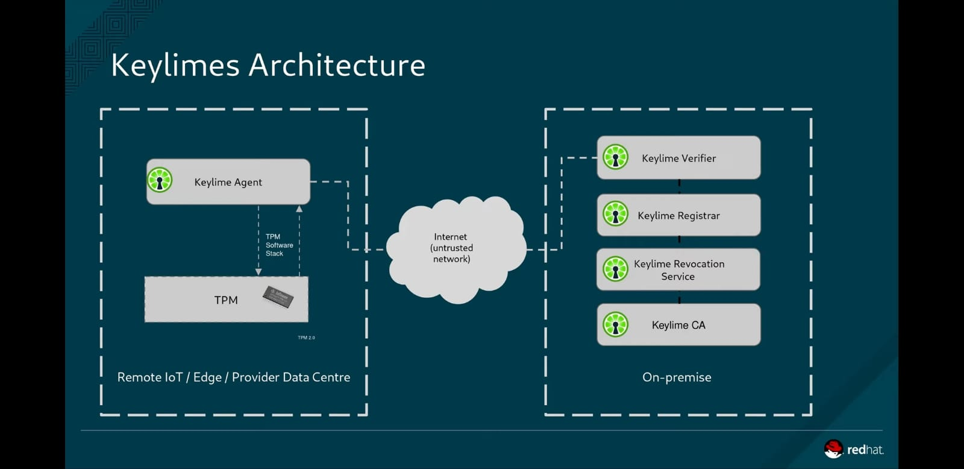

Slide 5
Target environment
Public/ Private / Hybrid cloud
Edge computing
IoT/ Embedded
All Architectures: x86, ARM

Slide 6
Azure RTOS
Azure RTOS is a real time operating system (RTOS) for IoT and edge devices powered by microcontroller units.
It is there o support constrained devices . Its battery powered and also have less than 64 kb of flash memory
It gives IP and socket-layer security via industry standard protocols and compliance standards.
Azure RTOS uses hardware cryptographic and memory protection capabilities

Slide 7
Components of Azure RTOS
Azure RTOS ThreadX: Azure RTOS ThreadX provides are advanced scheduling facilities, message passing, interrupt management, and messaging services
Azure RTOS FileX: designed to have a small footprint and high performance, making it ideal for today's deeply embedded applications that require file operations
Azure RTOS GUIX: small, fast, and easily ported to virtually any hardware configuration capable of supporting graphical output

Slide 8
Azure RTOS NetX: high-performance implementation of TCP/IP protocol standards. It has a unique Piconet architecture
Azure RTOS NetX Duo: it is an advanced, Industrial Grade TCP/IP network stacks designed specifically for deeply embedded, real-time, and IoT applications.
Azure RTOS USBX: high-performance USB host, device, and On-The-Go (OTG) embedded stack

Slide 9
Zephyr real-time operating system (RTOS)
The Zephyr Project is a scalable real-time operating system (RTOS) supporting numerous hardware architectures; it's streamlined for asset obliged gadgets and fabricated explicitly in view of security.
It gives item developers the adaptability to single out highlights and usefulness dependent on the size of the footprint that they're working with.
It is licensed using the Apache 2.0 license

Slide 10
Features
Wide range for service for kernel support like multiMulti-threading Services, Memory Allocation Services, Inter-thread Synchronization Services, Power Management Services.
Multiple scheduling algorithm
Modular for flexibility
Cross Architecture Supports a wide variety of supported boards with different CPU architectures and developer tools
Memory Protection
Optimized Device Driver Model

Slide 11
Native Networking Stack supporting multiple protocols
Bluetooth Low Energy 5.0 support
Memory Protection
Optimized Device Driver Model
Powerful multi-backend logging Framework
User friendly and full-featured Shell interface
Native Linux, macOS, and Windows Development

Slide 12
Future of challenges of Zephyr
Challenges Facing Zephyr Is The Number Of Boards That Are Coming Out
More boards mean more code-level help for these boards and every vendor contributes their own code to address their own utilization case. The task is striving to guarantee the stage is adaptable enough to suit new boards and use-cases without compromising quality.

Slide 13
References
What is Microsoft Azure RTOS,(2020,19 May), Microsoft, Retrieved from https://docs.microsoft.com/en-us/azure/rtos/overview-rtos
Keylime Documentation .(2020, 16 May), Keylime developers Retrieved from https://readthedocs.org/projects/keylime-docs/downloads/pdf/latest/
Keylime documentation. (2020 .28 May), Keylime developers Retrieved from
https://github.com/keylime/keylime
Swapnil Bhartiya (December 14, 2018),, The Power of Zephyr RTOS Retrieved from https://www.linuxfoundation.org/blog/2018/12/the-power-of-zephyr-rtos/
Zephyr (2019)..The Zephyr Retrieved from
https://docs.zephyrproject.org/latest/introduction/index.html

